Slide 1

Edesia
Sprint Retrospective #8
Team Blue
Adam Bowers | Daniel Wingo | Stephen Bennett | Jonathan Holley
Github: aLotofAdam | 81wingo | stephenbennett2 | mccauley747
UNCG: ajbower3 | dtwingo | scbenne3 | jbholley

Slide 2



Slide 3
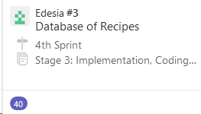
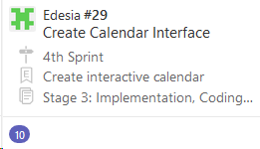
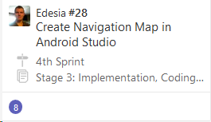
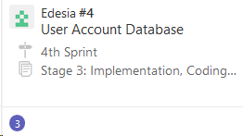
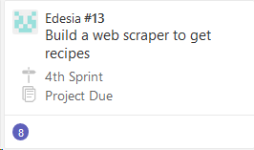
Last Sprint
Navigation Components
Database
Web Scraper
Calendar UI

Slide 4
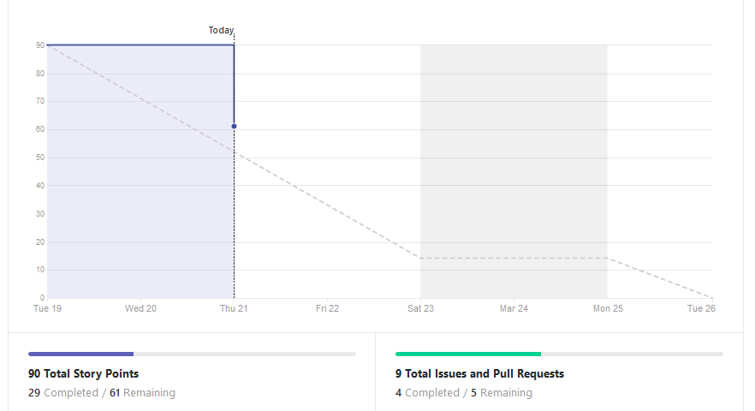
Burndown Chart

Slide 5
Current Sprint
NavHost, Controller
Presentation Layer
Database
Login/out UI
Sign Up UI
Main Subsystems UI

Slide 6
Navigation Components
Navigation
Host
Controller
Map
Activities
Fragments

Slide 7
Database
Database created with user information and recipe
information being imported from CSV file currently.
Working with web scraper to possibly populate recipe
data directly from scraper.
Goal this week is to be fully functional with scraper
and begin to help with connections in middle layer.

Slide 8
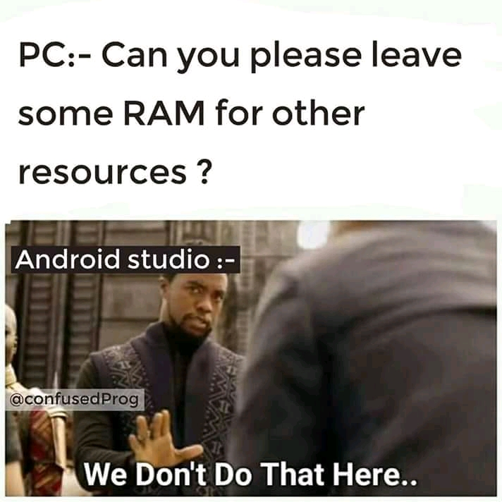
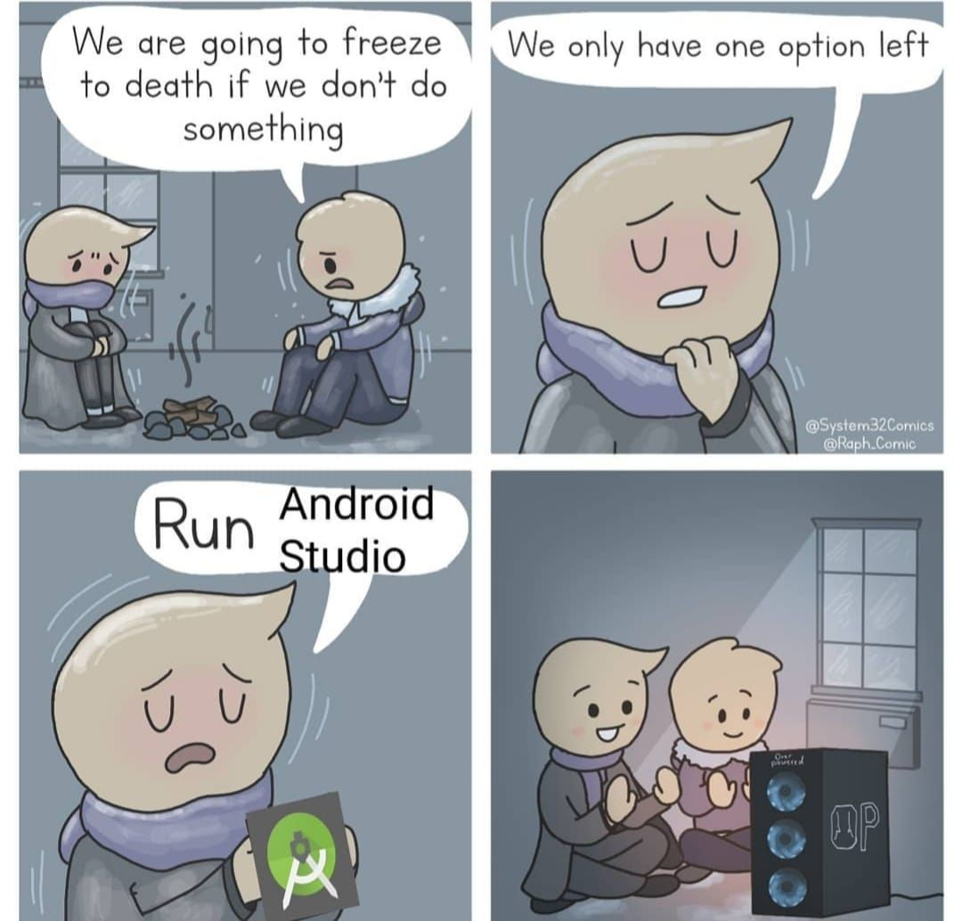
Web Scraper
Web scraper is DONE!
Now working on Android Studio and Middle Layer

Slide 9
GUI
Fleshed out Log in GUI
Fleshed out Sign Up GUI
Began to flesh out main subsystems
Began work on middle layer to create functionality.

